Slide 1
Online Anonymity Using the TOR Network (featuring a hardened Raspberry Pi Wireless Access Point)
By Steven Richmond

Slide 2

Common Misconception
The Tor Project, which is the non-profit organization that maintains the TOR Network, doesn’t do what they do just for people to access the ‘Dark Web’ and do illegal stuff. Sure, it enables it, but it does not condone it. It’s like blaming the gun for shooting something.
There is a variety of more appropriate utilizations and users
Whistleblowers, Journalists, Bloggers, Lawyers, and anyone who values privacy
“… it is clear the absolute most important thing you can do to maintain your anonymity is reduce the number of places in your operational activity where you can make mistakes…”
- Edward Snowden, NSA whistleblower

Slide 3

Statement of Purpose
"Tor makes all of its users to look the same, which confuses the observer and makes you anonymous. So, the more people use the Tor network, the stronger it gets, as it's easier to hide in a crowd of people who look exactly the same."

Slide 4
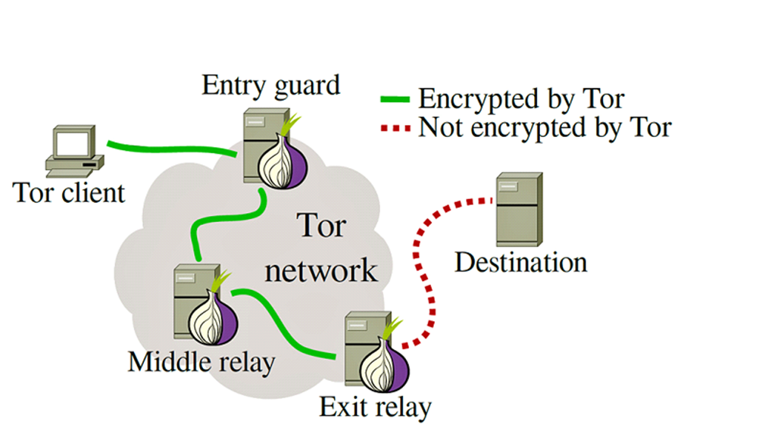
What is the TOR Network?
TOR stands for The Onion Router
Layers!
It offers multi-layer protection by encapsulating the source data several times AND only passing along relevant information, particularly the network location of the next hop. Once the packet reaches the destination, the true origin is no longer known. In order to get ‘home’, a digital circuit maintains the path of nodes and is destroyed and rebuilt every 10 minutes.
Only works because users volunteer their machines to act as relay nodes. Currently about 7,000 relay nodes out there.

Slide 5
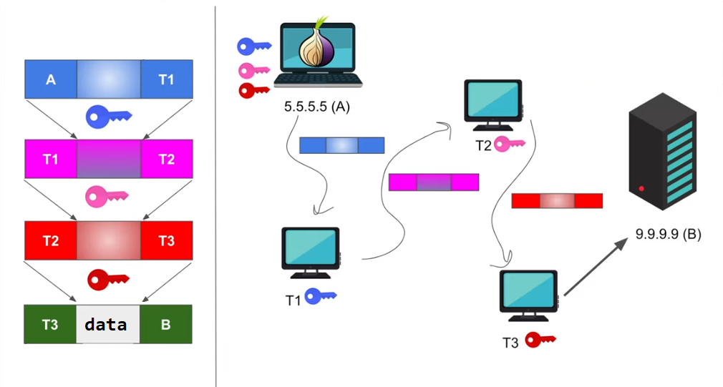

Relays and Encryption

Slide 6
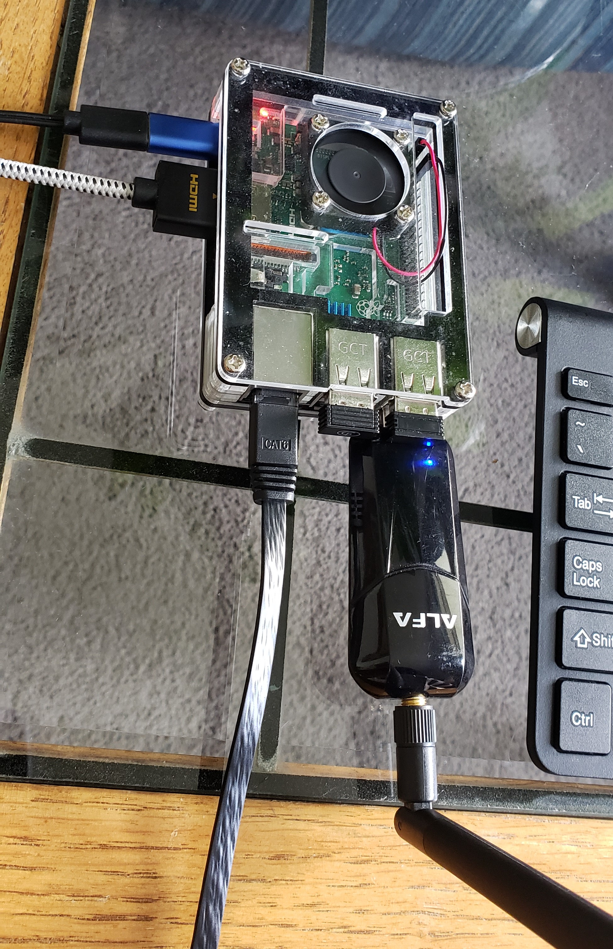
Taking it one step further…
Raspberry Pi TOR proxy access point
Rather than having to install a TOR client (such as Tor Project’s TOR Browser) on each device and handling it at the application level, this automatically forwards ALL traffic from ALL connected devices on the network level.
wlan0 interface ‘masquerading’ as eth0
Manually set up hostapd (host access point daemon) and iptables to properly pre-forward and post-forward traffic.
First hop before entry (guard) node

Slide 7
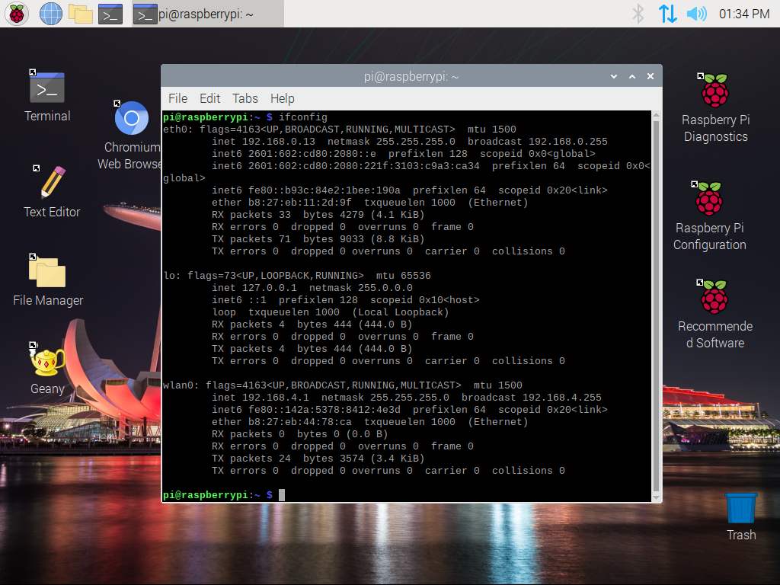
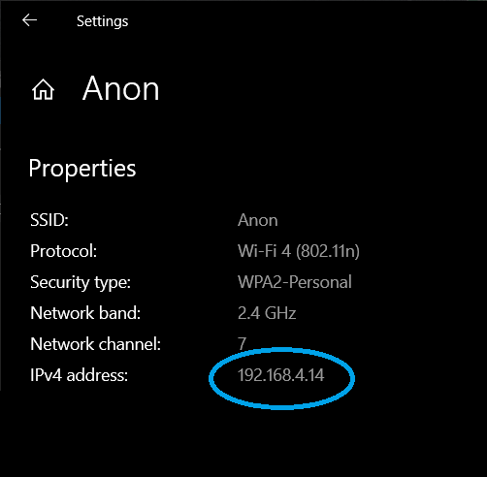
Implementation

Slide 8
Huge caveat:
Sloooooowwwww
That’s all.
Stay safe out there.

